Slide 1




General Assembly | 3rd July
Unlocking Magna's Potential: A Journey Through Data
Presented by: Qasim Al Qatari

Slide 2
Overview
1.
Introduction
5.
Data overview
2.
Problem Statement
6.
Key findings
3.
Smart Goal
7.
Recommendations
4.
8.
Limitations
Objectives

Slide 3
Introduction & Context
Our partnership with Magna Middle East: E-commerce platform
It began with a call from an old friend at Magna.me. He'd seen our success helping other e-commerce platforms achieve remarkable growth, retain clients, and expand their user base.
He knew Magana faced similar challenges and needed more than just data – they needed deep, actionable insights. Trusting our proven track record, he asked us to help them unlock their full potential.
And so, our partnership began. Today, we're excited to share the insights from our analysis of their e-commerce order data, aimed at enhancing customer experience and optimizing operations.

Slide 4
Problem Statement
Low Customer Retention
Operational Inefficiencies
High Order Cancellation Rate

Slide 5
\
Project Objectives
What We Aimed to Achieve
Customer Behavior Understanding
Identify Operational Diagnostics
Transaction Pattern Understanding
Actionable Strategy and recommendation

Slide 6





Data Overview
Data Sources: Historical E-commerce Order Files (50 CSVs) Data Size: (42864/41)
Order Timelines
Customer Insights
Employee Performance
Order Details
Transaction Types
record_dateview_date
record_time view_time, record_hour
ip_address
Customer_Segment
pos_session_id
order_id, total_price discount
order_status incomplete_reason
order_type, payment_type
is_discounted

Slide 7
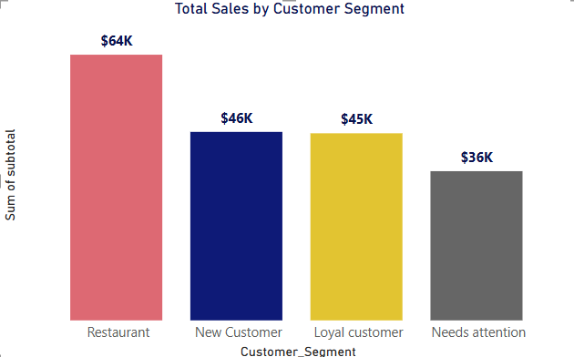
Key Finding 1 - Customer Segmentation
Understanding Our Customer Base by IP Address
Methodology: Recency, Frequency, Monetary analysis, using IP address as a customer proxy.
Segments Identified:
Restaurant
Loyal Customer
Needs Attention
New Customer
Lost/Churned Customer

Slide 8
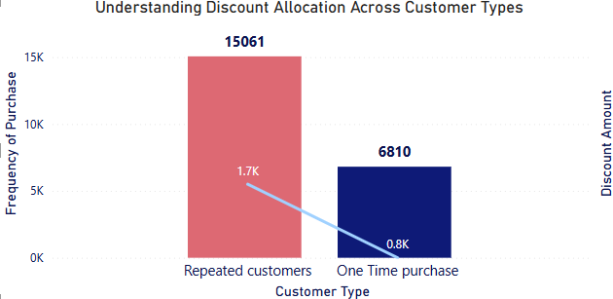
Key Finding 2 - Customer Purchase Behavior
One-Time vs. Repeated Customers
Observation: A significant portion of customers are "One Time purchase".
Implication: Challenges in converting initial buyers into repeat customers.
Opportunity: Strategies to increase repeat purchases from this segment.

Slide 9
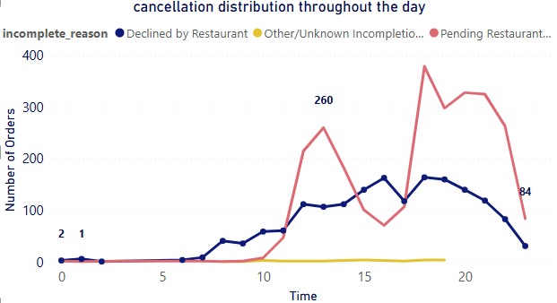
Key Finding 3 - Incomplete Orders
Why Orders Don't Complete
Dominant Reasons:
Pending Restaurant Response
Declined by Restaurant
Insight: Operational bottlenecks primarily lie with restaurant interaction and internal processes.

Slide 10
Key Finding 4 - Employee Performance & Responsiveness
Operational Efficiency Insights (POS Session ID)
Order Handling: Significant variation in order volume and sales processed by different employees.
Declined Orders: Some employees are associated with a higher number of declined orders, indicating potential training needs or process issues.
Response Time:
Average Response Time: 36.04 minutes.
Median Response Time: 1.15 minutes.
Observation: Generally efficient, but outliers suggest specific bottlenecks.

Slide 11
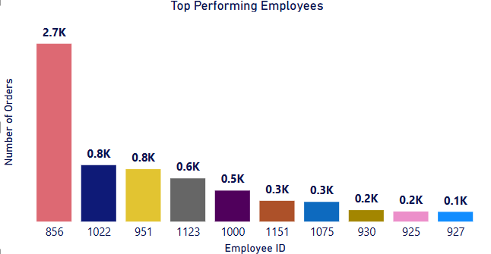
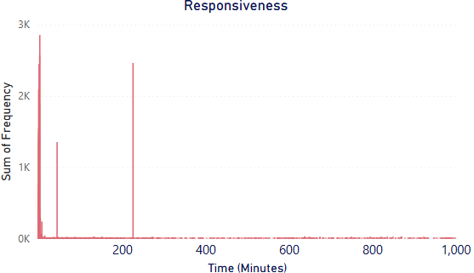
Key Finding 4 - Employee Performance & Responsiveness

Slide 12
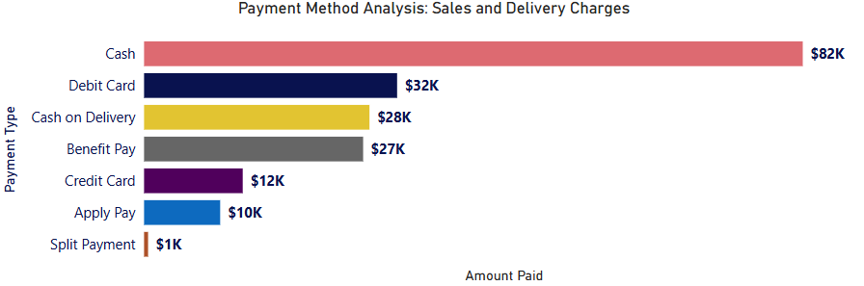
Key Finding 5 – Transaction Patterns
Payment Methods & Discounts
Popular Payment Methods: Cash and Debit Card are most dominant, indicating local preferences.
Discount Prevalence: Discounts are frequently applied, mostly small amounts, but some larger ones exist. The is_discounted flag helps track this.

Slide 13
Recommendations
Actionable Strategies for Growth & Efficiency
Customer Retention:
Re-engagement: Targeted campaigns for “One Time Purchase” customers (e.g., personalized discounts).
Loyalty Programs: Incentivize "Needs Attention" customers for increased frequency.
Onboarding: Structured incentives for "New Customers" to encourage second purchase.
Operational Improvement:
Restaurant Communication: Enhance real-time communication and menu updates to reduce "Pending" and "Declined" orders.
Employee Training: Address performance gaps for employees with high declined order rates.
Marketing Strategy:

Slide 14
Recommendations
Discount ROI: Analyze is_discounted data to refine promotion effectiveness.
Response Time: Investigate outliers to improve overall service speed.

Slide 15
Limitations and Assumptions
Important considerations
Limitations:
IP as Customer Proxy: Not always precise (shared IPs).
Data Scope: Limited to provided order data; external factors not included.
Missing Context: Deeper understanding of some status codes could enhance analysis.
Assumptions:
Data is largely accurate and reflects real transactions.
Key columns are sufficiently complete and reliable.
IP address and POS session ID consistently identify "customer units" and "employee units" respectively.

Slide 16
Conclusion & Next steps
Driving Data-Powered Decisions
Summary: This analysis provides foundational insights into customer behavior, operational challenges, and transaction trends.
Impact: Data-driven recommendations can lead to improved customer satisfaction, increased retention, and enhanced operational efficiency.
Future work
Integrate external data (e.g., marketing spend, customer demographics).
Implement A/B testing for recommendations.
Develop predictive models for customer churn or order volume.

Slide 17
Q&A
Questions?

Slide 18
General Assembly | 3rd July
THANK YOU
Presented by: Qasim Al Qatari

Slide 19
APPENDIX: Data Handling
From Raw Data to Actionable Insights
Combination: Merged 50 raw CSVs into one comprehensive dataset.
Cleaning:
Dropped 70+ irrelevant columns.
Converted timestamps to proper datetime objects for accurate calculations.
Standardized numeric and string fields, handling missing values.
Mapped payment types: csh to Cash, bfp to Benefit Pay, etc., for clarity.
New Feature: Created is_discounted (True if discount > 0).
Removed duplicate rows.
Filtered out erroneous entries (e.g., 'Unknown' IP addresses, system-related order types).
Critical Integrity Check: Removed completed orders with 0 paid amount.

